Slide 1
OGC API Map Tiles
OGC API Hackathon 2019
London, United Kingdom
20 June 2019

Slide 2
Introduction
Defines an OGC standard for a Web Map Tile API that can serve map tiles of spatially referenced data
Describes the discovery and query operations of an API that provides access to Map Tiles in a manner independent of the underlying data store
Builds upon the WMTS standard and recent work on Tiled Feature Data

Slide 3
OGC API Common – Paths (1)
Path = /
Returns landing page (inherited from OGC API - Common)
Path = /conformance
Returns a set of conformance class URIs. (inherited from OGC API - Common)
Path = /collections
Returns metadata describing the collections accessible through this API (inherited from OGC API - Common)
Path = /collections/{collectionId}
Returns metadata describing the collection identified by {collectionId}
Path = /collections/{collectionId}/queryables
Returns the queryable properties of the feature collection
Path = /collections/{collectionId}/items
Returns features of the feature collection
Path = /collections/{collectionId}/items/{featureId}
Returns a feature
Path = /tileMatrixSet
Returns all available tile matrix sets (tiling schemes)

Slide 4
OGC API Common – Paths (2)
Path = /tileMatrixSet
Returns all available tile matrix sets (tiling schemes)
Path = /tileMatrixSet/{tileMatrixSetId}
Returns a tiling scheme by id
Path = /tiles/{tileMatrixSetId}/{tileMatrix}/{tileRow}/{tileCol}
Returns a tile of the dataset
Path = /collections/{collectionId}/tiles/{tileMatrixSetId}/{tileMatrix}/{tileRow}/{tileCol}
Returns a tile of the collection with or without style
Path = /tiles/{tileMatrixSetId}/{tileMatrix}/{tileRow}/{tileCol}/info
Returns information on a point of a tile with or without style

Slide 5
OGC API Common – Paths (3)
Path = /collections/{collectionId}/tiles/{tileMatrixSetId}/{tileMatrix}/{tileRow}/{tileCol}/info
Returns information of a point in a tile of the collection with or without style
Path = /tiles/{tileMatrixSetId}
Returns tiles from several collections.
Path = /collections/{collectionId}/tiles/{tileMatrixSetId}
Returns tiles of a collection
Path = /map
Returns a map of collections with or without style
Path = /collections/{collectionId}/map
Returns a maps from the collection with or without style
Path = /map/info
Returns information about a map of the collection with or without style
Path = /collections/{collectionId}/map/info
Returns information about a map from the collection with or without style

Slide 6
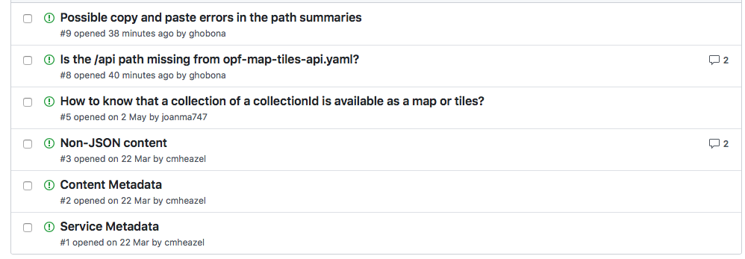
Issues

Slide 7
Points of Contact:
Joan Maso
Joan.Maso@uab.cat

